Slide 1
Benredia Deep Dive
By Aaron Gold

Slide 2
Background
Benredia has been on the market for a year and a half and has an incumbent competitor that they are trying to gain market share from
The brand team has requested that we do a deep dive on their 2017 data in order to determine areas of opportunity for the following year as well as areas of success that we should highlight. This data presentation will be shared with their executive team as well
The data we have is from every campaign in 2017 which all run for 1 month. The data includes: dates of campaign, platform (Facebook/ Instagram), creative name, Impressions, clicks, and spend. We can get CPC, CTR, and CPM from data as well

Slide 3
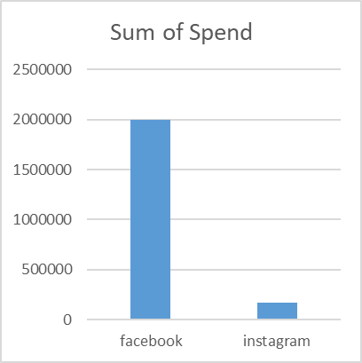
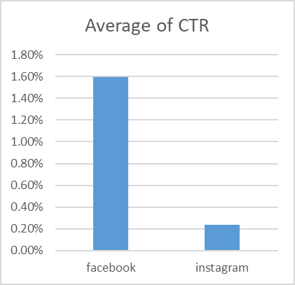
Sum of Spend and CTR by Platform
The graphs of CTR and Spend comparing Facebook and Instagram are similar. It makes sense that the ratios should be the same because if the CTR is higher then there should be more spending (as long as it does not cost too much more)
They should continue to spend more on Facebook since it has been very effective

Slide 4
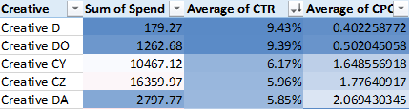

Top & Bottom 5 Creative Spend and CTR, CPC
Top 5 Creative Spend
Top 5 Average CTR
Bottom 5 Creative Spend
Bottom 5 Average CTR
Sum of Spend & CPC: High Low CTR: High Low
They should spend more on Creative D, DO, and less on Creative 5, and CI
Some are Neutral, and some are good/ bad (more next page)

Slide 5
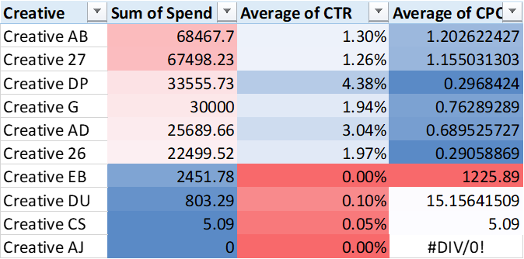
Good and Bad Creative Spend
Good Creative Spend
Bad Creative Spend
Good - Spend is dark red and CTR,CPC is dark blue, Or Spend is dark blue and CTR,CPC is dark red
Bad - Spend is dark red and CTR,CPC is dark red. Or Spend is dark blue and CTR,CPC is dark blue
Spend more on bad creative spend (right table) with sum of spend = dark blue, and less when
sum spend = dark red

Slide 6
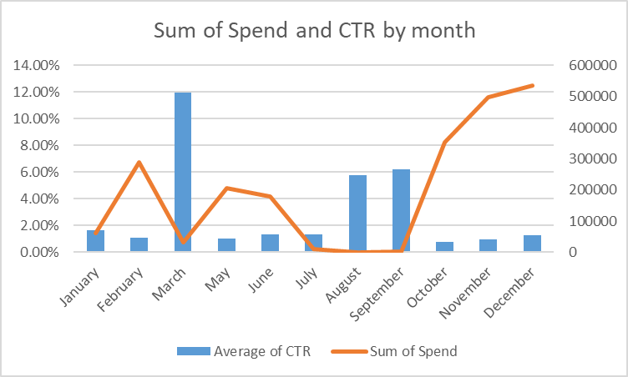
Spend and CTR by Month
Sum of spend seems to be inconsistent with CTR by month
Higher CTR is good because you can get a better return on investment if more people click on your ad as long as the CPC is not too high
March, August and September have the highest CTR so it would make sense to spend more during those months. Currently they are not spending much
They spend a lot at the end of the year even though the CTR is not great. They should allocate some of the funds to the higher CTR Months

Slide 7
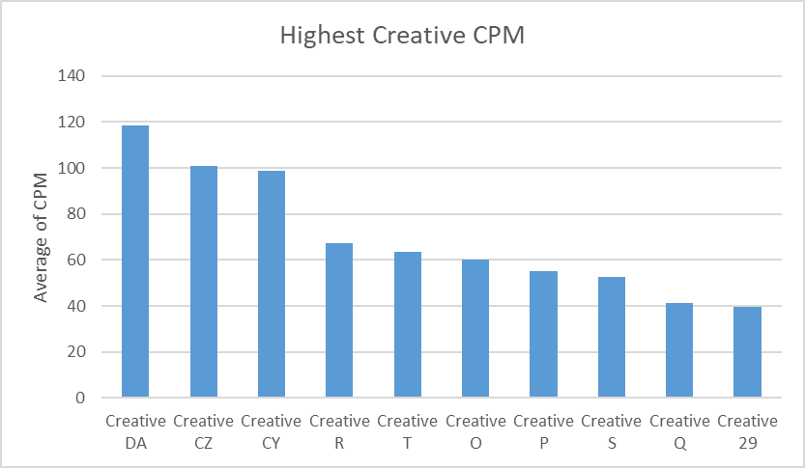
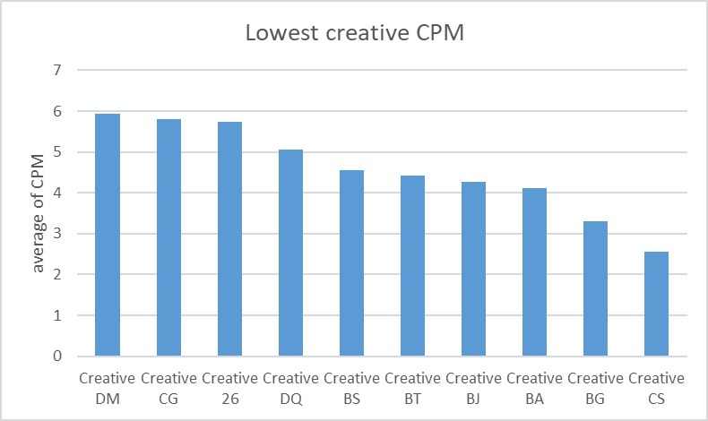
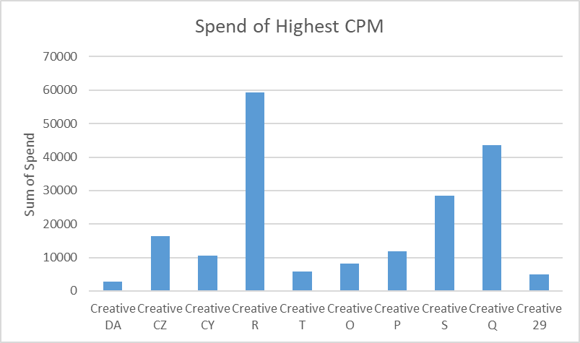
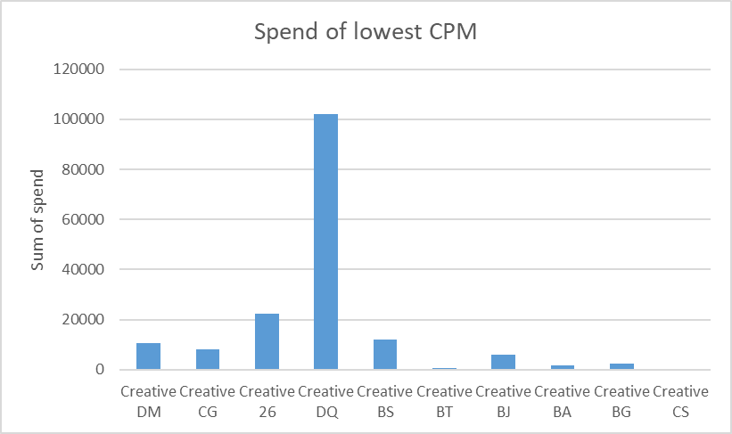
Creative CPM and Spend
CPM - Cost per Thousand Impressions: cost efficiency gauge for purchasing media. In mathematical terms: CPM = Spend/(Impressions/1000)
They should spend less on creative “R”, and “Q” since they have a high CPM. It is good that they spend a lot on creative “DQ” since it has a low CPM
They may want to spend more on the lower CPM if other KPI’s are in their favor

Slide 8
Summary
Key takeaways
Benredia should take into account factors such as CTR, CPM, CPC, and month of year to determine how and when they should spend on campaigns
They should continue to spend on Instagram and Facebook since those are 2 of the major social media platforms. However they should still spend more on Facebook since CTR is higher
They should spend more on creatives that have a have a high CTR and low CPC, and less on creatives do not. allocate more money from ‘bad” creatives to “good” creatives
They should spend more during months that have higher CTR rates and less during months with lower CTR rates.
Take into account CPM which is the cost efficiency gauge for purchasing media. If it is high they should not spend too much money

Slide 9

Other factors to consider…
Information on where the ad was placed such as which website, or what device such as a tablet, mobile, or pc. Also the sizing and placement of the ad such as banner vs rectangle, and where it is on the page. --It is important to know this since an ad may perform differently depending on where/ how it is seen.
Likes, comments, and shares are important, and not only the CTR but whether the goal of the campaign was reached (conversion rate) – such as was an item purchased as a result of the ad.
The End

